Slide 1
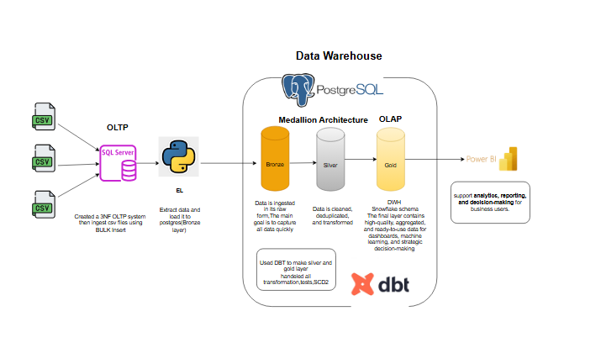

Slide 2
Project Overview & Architecture
The Goal: Create OLTP database (Northwind) from scratch ,Transform raw Northwind business data into actionable insights for decision-makers.
The Stack: SQL Server (OLTP), Python (ETL), PostgreSQL (DWH), dbt (Transformation), and Power BI (Analytics).
BI).

Slide 3
Phase 1: OLTP Database Design (The Source)
Relational Modeling: Designing the Northwind schema from scratch.
ERD & Mapping: Implementing entities with strict cardinality and participation constraints.
Data Integrity: Implementing Primary Keys, Foreign Keys, and Check Constraints in SQL Server.
Initial Ingestion: Using Bulk Insert to populate the system with CSV data efficiently

Slide 4
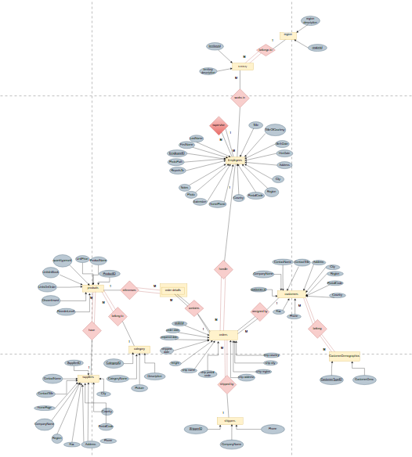
ERD

Slide 5
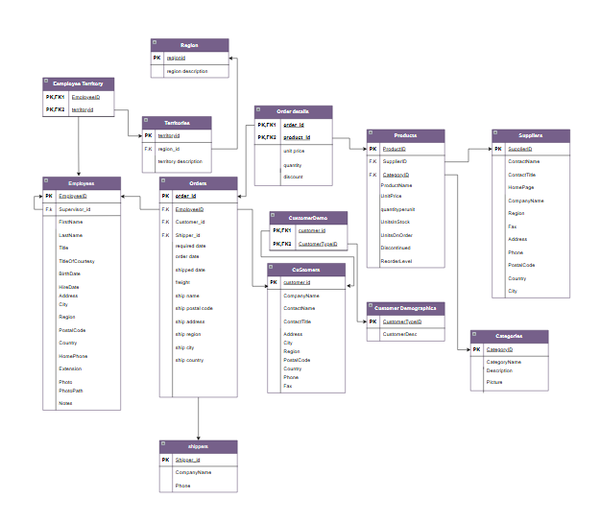
Mapping

Slide 6
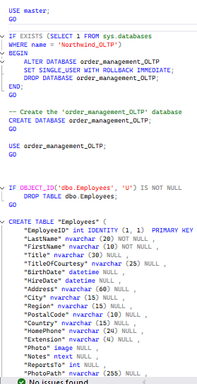
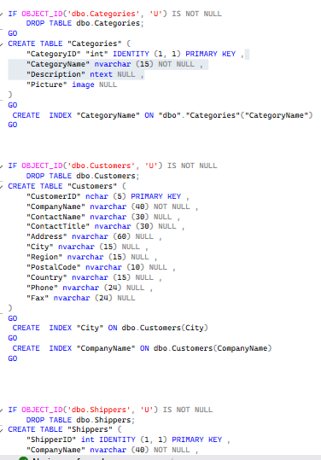
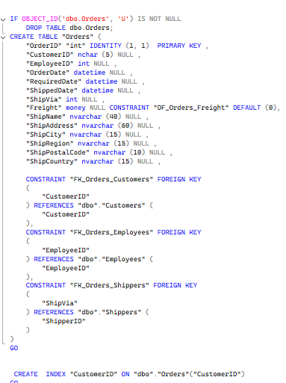
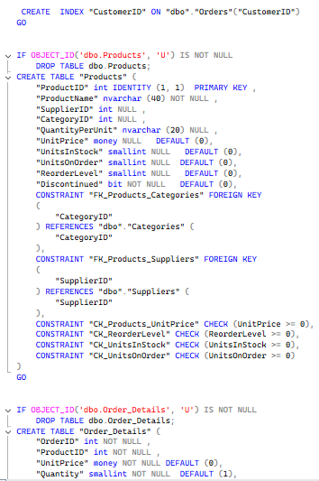
Database Implementation

Slide 7
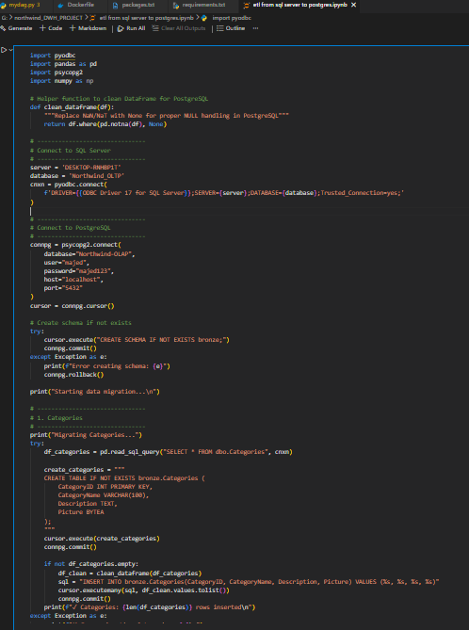
Phase 2: The Ingestion Layer
(Extraction-loading)
Setting up PostgreSQL as the Target Data Warehouse.
Python ETL: Writing custom Python scripts to bridge the gap between SQL Server and Postgres.
Bronze Layer: Loading "Raw" data into the storage layer without changes to preserve history.
Python Creates Tables and issues Data Definition Language (DDL) commands to create the destination tables with specific column names and data types before the data is fully inserted.
Data Insertion: The data is then written into these newly created, structured tables.

Slide 8
Phase 3: Data Transformation (dbt & Silver Layer & Gold layer)
Cleaning & Standardization: Removing duplicates, handling nulls, and formatting data.
SCD Type 2 Implemented : using snapshots to track historical changes (e.g., changes in employee roles or product prices).
Modular SQL: Writing reusable dbt models to separate logic from final presentation.
Implementing dbt tests (unique, not null, relationship tests) to ensure data reliability.
Documentation: Generating dbt docs and lineage graphs to make the data understandable for others
.

Slide 9
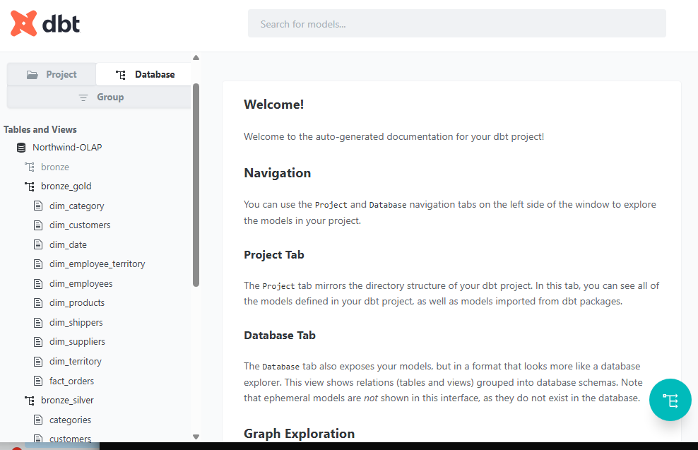
DBT Docs

Slide 10
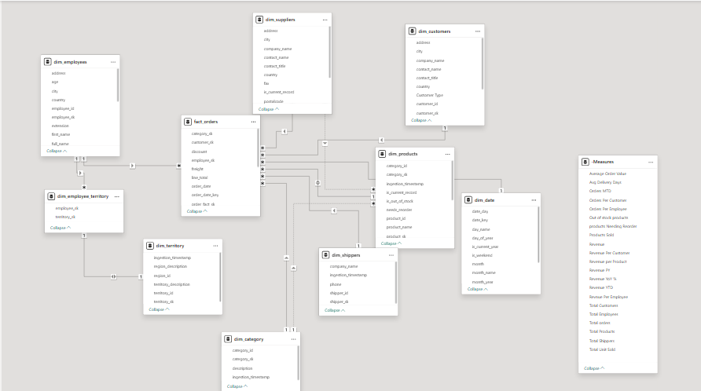
Phase 4: Dimensional Modeling (Gold Layer)
Snowflake Schema: Organizing data into Fact and Dimension tables for optimized analytical performance.

Slide 11
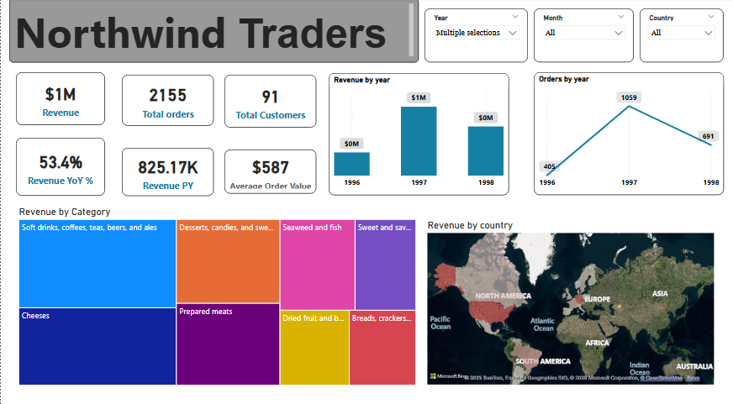

Slide 12
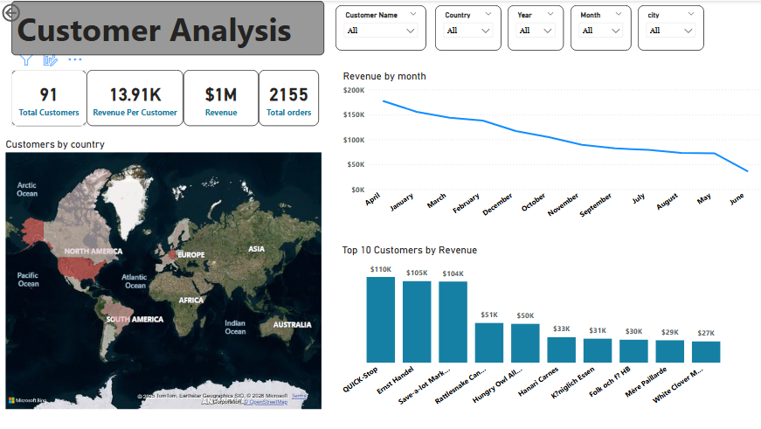

Slide 13
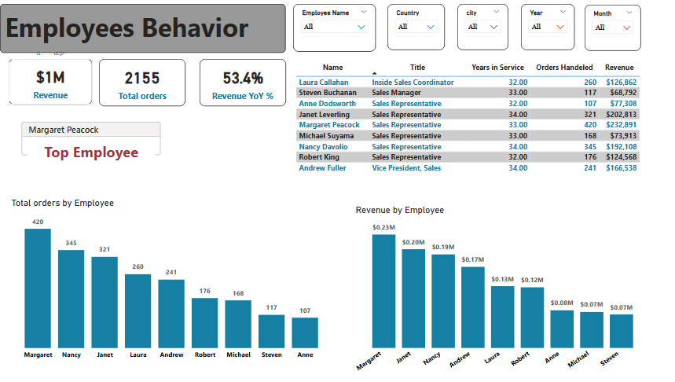

Slide 14
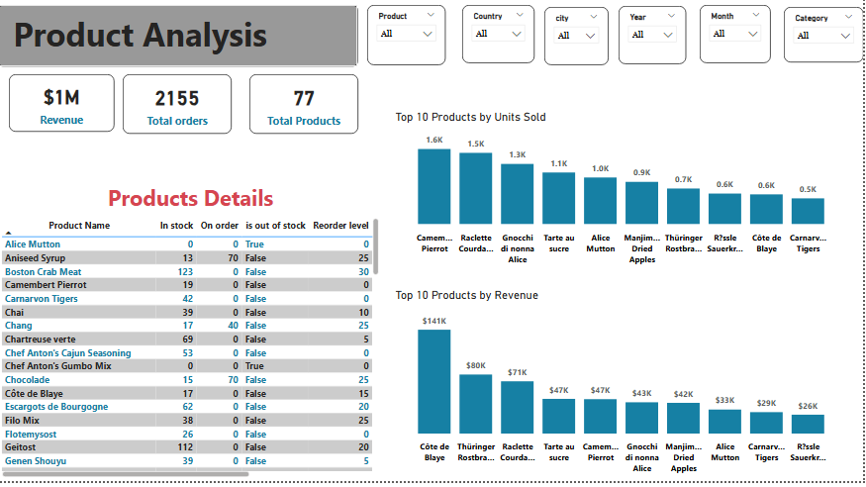

Slide 15
